Slide 1
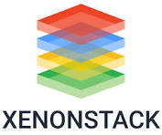

Presentation on L1 MODULE3

Slide 2
CONTENTS
CI/CD A Gentle Introduction
Cloud Basics
Configuration Management
Deployment Strategies
What is DevOps
Infra as Code Basics
Linux
" Linux Custom Script Tasks"

Slide 3
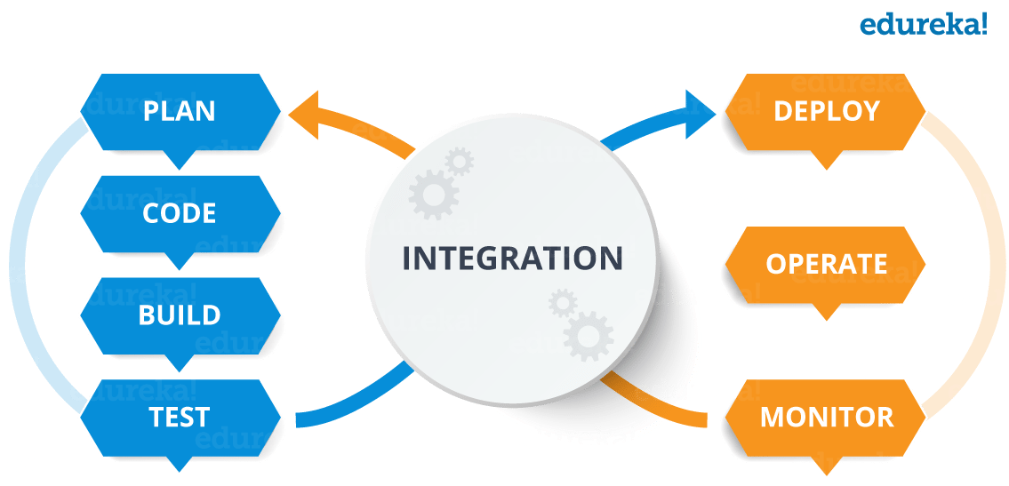
A CI/CD pipeline is an automated process that allows teams to quickly develop, test, and deploy applications. It integrates continuous integration (CI)—where developers frequently merge and test code changes in a central repository—with continuous delivery (CD), which automates the deployment of those changes to production or other environments.
CI, short for Continuous Integration, is a software development practice in which all developers merge code changes in a central repository multiple times a day. CD stands for Continuous Delivery, which on top of Continuous Integration adds the practice of automating the entire software release process.
Ci/CD-A Gentle Introduction

Slide 4
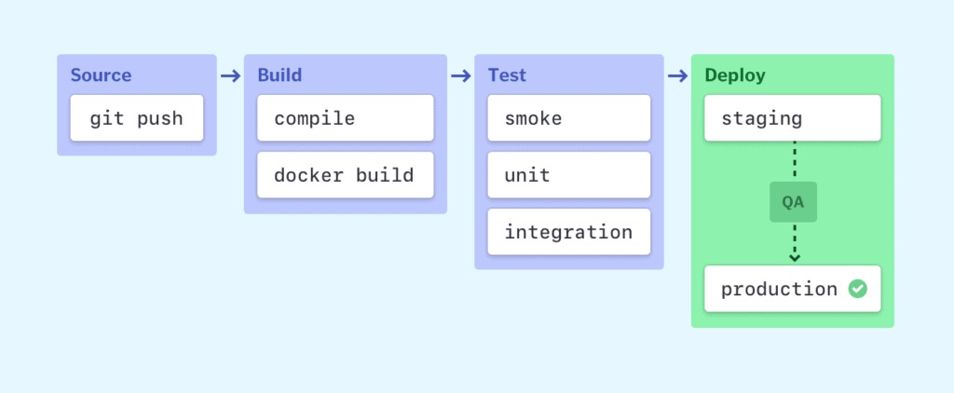
Elements of a CI/CD pipeline
Source stage: It keeps track of all code changes and triggers the pipeline when changes are detected.
Build and Test stage: It combines your code and its dependencies, runs automated tests, and ensures your code is correct and ready to go.
Deploy stages: This determines how your code changes are released to the various environments, be it staging or production.

Slide 5

CLOUD Basics
Cloud computing is the on-demand delivery of computing services, such as servers, storage, databases, networking, software, analytics, and more, over the Internet ("the cloud").
AWS: Amazon Web Services (AWS) is the world’s most comprehensive and broadly adopted cloud, offering over 200 fully featured services from data centers globally.
Microsoft Azure: It is also a cloud service provider offering multiple cloud services just like AWS.

Slide 6



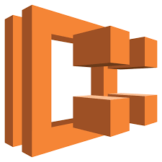
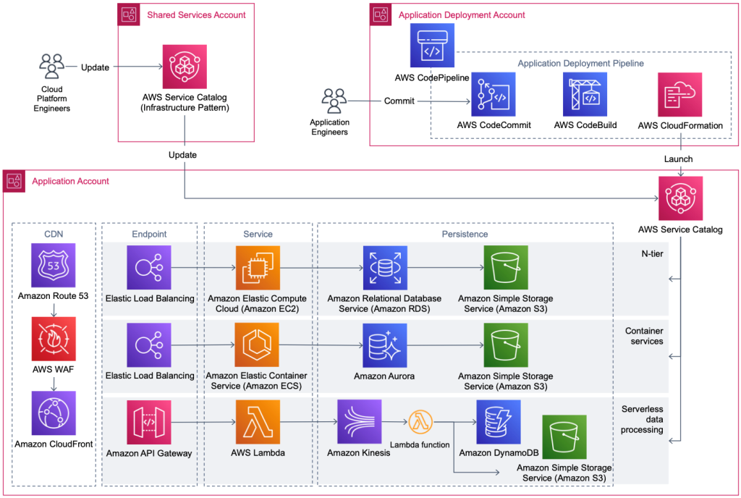


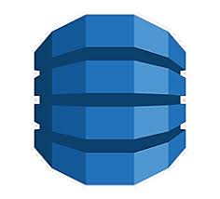
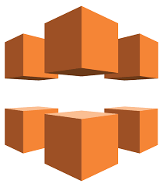
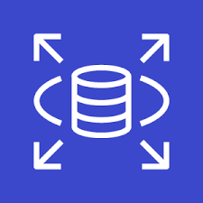


SOME OF The popular AWS SERVICES Build, Deploy, and Manage Websites, Apps or Processes On AWS Secure, Reliable Network.
AWS CloudTrail
AWS CloudWatch
AWS EKS
AWS ECS
AWS EC2
AWS EBS
AWS ELB
AWS Lambda
AWS DynamoDB
AWS CloudFront
AWS RDS
AWS VPC
AWS S3
AWS WAF

Slide 7
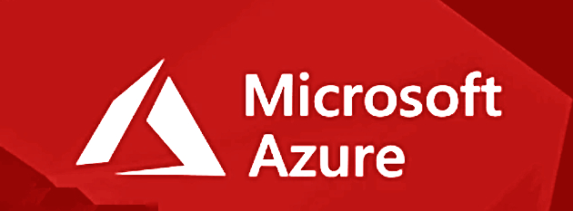
AZURE TOOLS/services Azure Services offers a powerful set of cloud-based tools to help businesses scale, manage, and deliver applications effectively.
Azure Active Directory: It is a cloud-based identity and access management service that helps you securely manage access to your apps and data.
Azure Data Factory: A cloud-based service that helps you integrate and transform data from various sources.
Azure SQL: It allows you to manage your relational databases in the cloud without worrying about the infrastructure.
Azure Functions: It is a serverless computing service that simplifies running your code on demand.
CosmosDB: It is a globally distributed, multi-model database designed for modern applications.
DevOps: A cloud-based service that simplifies managing the software development lifecycle.
Azure Backup: A cloud-based service designed to protect your data. It offers a simple and secure way to back up and restore your data, ensuring your important information is safe.
Virtual Machine: Lets you create and manage virtual machines in the cloud. You can choose the operating system that best suits your needs
Azure CDN: It is designed to speed up the delivery of web content by caching it on servers located around the world.

Slide 8
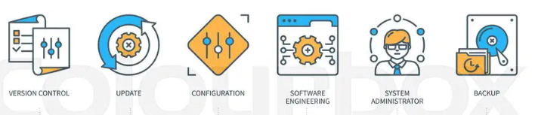
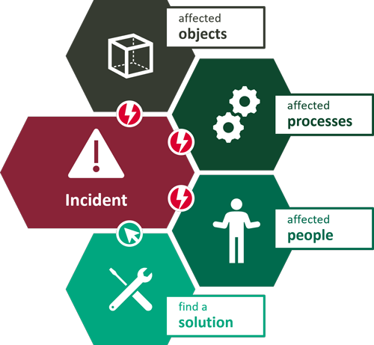
Configuration Management
The process of maintaining systems, such as computer hardware and software, in a desired state. Configuration Management (CM) is also a method of ensuring that systems perform in a manner consistent with expectations over time. It helps prevent undocumented changes from working their way into the environment. ​ ​
A Configuration management system allows the enterprise to define settings in a consistent manner, then to build and maintain them according to the established baselines.
A configuration management plan should include a number of tools that:
1.Enable classification and management of systems in groups
2.Make centralized modifications to baseline configurations
3.Push changes automatically to all affected systems to automate updates and patching
4.Identify problem configurations that are underperforming or non-compliant
5.Automate prioritization of actions needed to remediate issues
6.Apply remediation when needed. ​

Slide 9
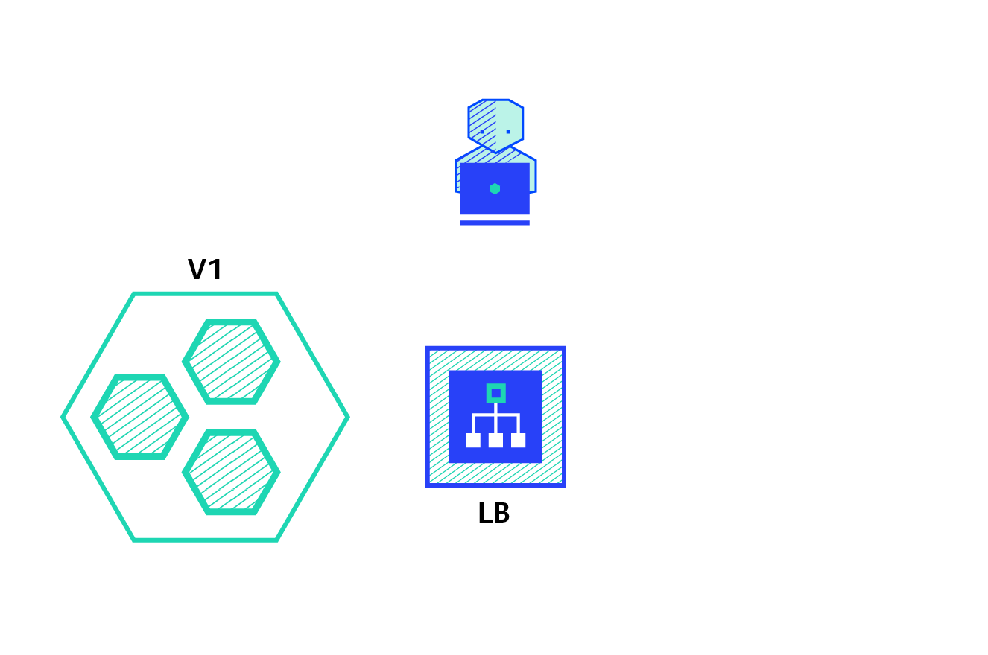



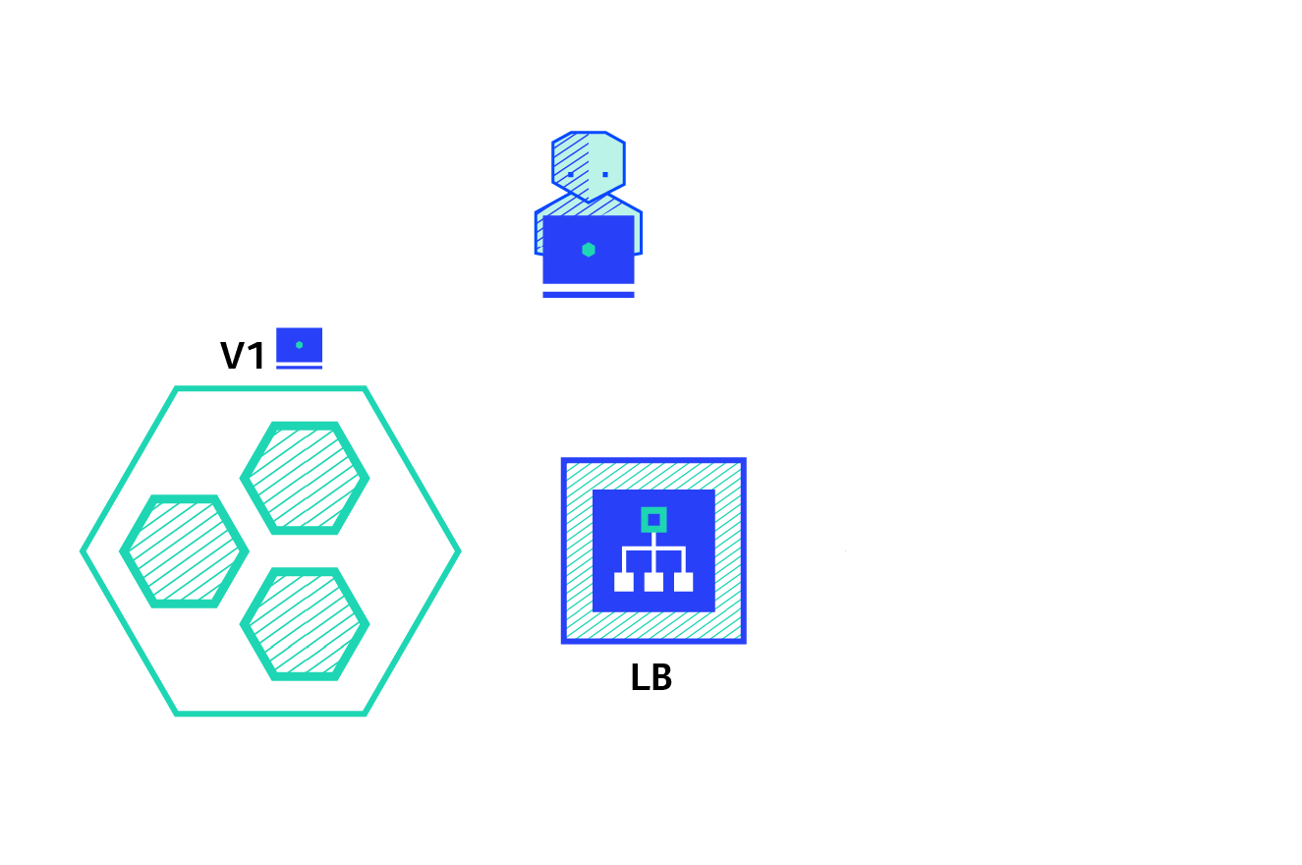

Deployment Strategies Variety of techniques to deploy new applications to production
Recreate: Version A is terminated then version B is rolled out.
Blue/Green: Version B is released alongside version A, then the traffic is switched to version B.
Canary: Version B is released to a subset of users, then proceed to a full rollout.
A/B testing: Version B is released to a subset of users under specific condition.
Shadow: Version B receives real-world traffic alongside version A and doesn’t impact the response.
Ramped (also known as rolling-update or incremental): Version B is slowly rolled out and replacing version A.

Slide 10
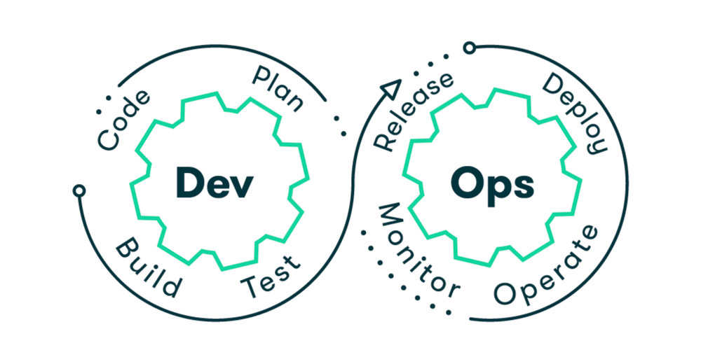
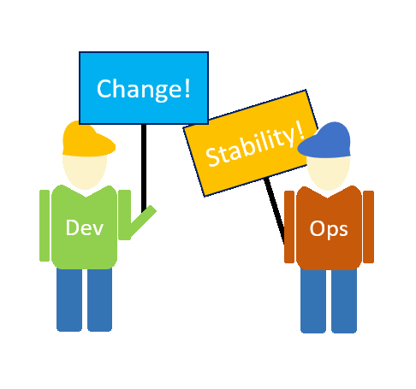
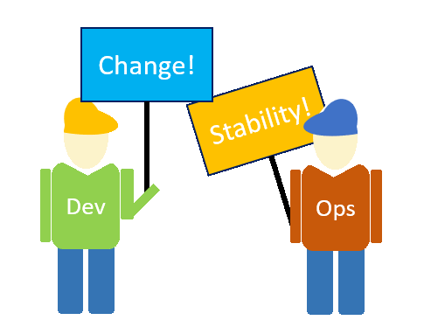
DEVOPS(DEV+OPS)
DevOps is the combination of cultural philosophies, practices, and tools that increases an organization's ability to deliver applications and services at high velocity: evolving and improving products at a faster pace than organizations using traditional software development and infrastructure management processes.

Slide 11
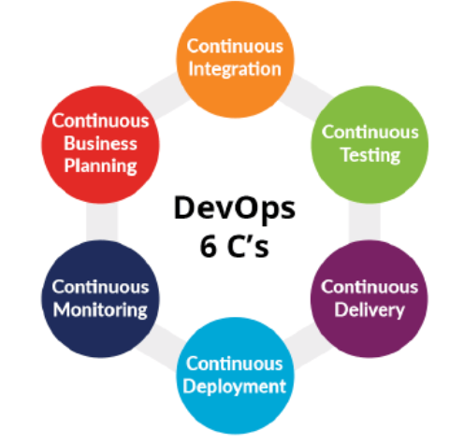
6C's of Devops
Continuous Integration: This means isolated changes are tested and reported when added to a larger codebase.
Continuous Testing: Continuous Testing obtains immediate feedback on the business risk associated with Software Releases.
Continuous Delivery: It is the ability to make changes like including new features, configuration management, fixing bugs and experiments into production.
Continuous Deployment: The code is automatically deployed to the production environment as it passes all the test cases.
Continuous Monitoring: It is a reporting tool because developers and testers understand the performance and availability of their application, even before it is deployed to operations.
Continuous Business Planning: Continuous Business Planning begins with determining the resources required by the application.

Slide 12
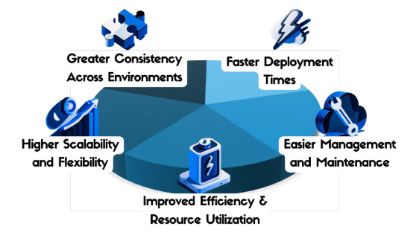
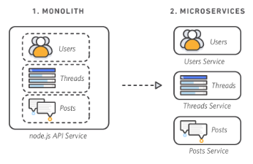
Technologies and Terminologies in its Processes
Microservices
It is an architectural and organizational approach to software development where software is composed of small independent services that communicate over well-defined APIs. These services are owned by small, self-contained teams.
Container
Container is a collection of a code its dependencies, libraries, runtime and system tool which are needed to execute itself independently.It is a running insance of a docker image.

Slide 13
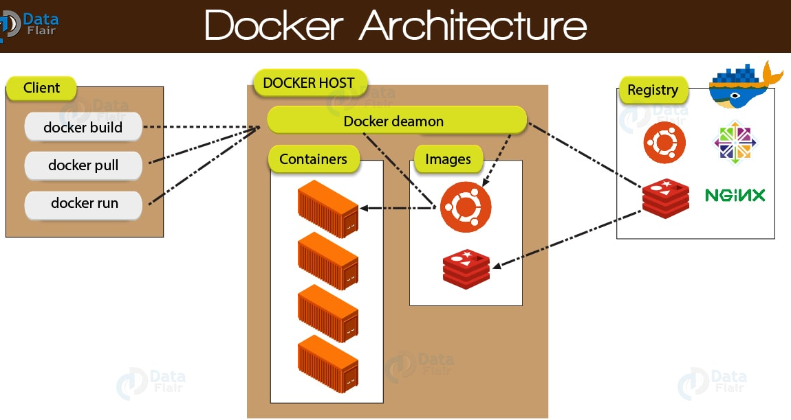
Docker
Docker is a software platform that allows you to build, test, and deploy applications quickly. Docker is a software platform that packages software into containers.
Docker Host
A Docker Host runs the Docker Daemon. As its job role, the daemon listens for Docker API requests such as ‘docker run’, ‘docker builds’, anything and also manages Docker objects like images, containers.
Docker Registry
This is the storage component for Docker images. We can store them in a public or private repository. We can create our own image or we can use public registries such as Docker Hub and Docker Cloud.
Docker Image
A Docker image is a blueprint of code that is executed in a Docker container. To use Docker, you add layers of core functionalities to a Docker image that are then used to create a running container.

Slide 14
Infrastructure as code the ability to provision and support your computing infrastructure using code instead of manual processes and settings.
Scripts
Templates
Policies
Infrastructure as Code (Iac)
Terraform
Ansible
Chef
Aws CloudFormation
Tools
Infrastructure
Provisioned Accordingly
Push
USER
Writes Code
Pull
VERSION CONTROL

Slide 15
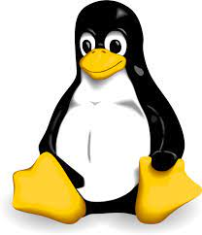
Linux-Operating System
Linux is a free and open-source family of operating systems that is resilient and flexible. In 1991, an individual by the name as Linus Torvalds constructed it.
The system’s source code is accessible to everyone for anyone to look at and change, making it cool that anyone can see how the system works. People from all across the world are urged to work together and keep developing Linux due to its openness.
Operating System: It is a software that communicate with the hardware and allows other programs to be run.
Basics Features of Linux:
Portable-Portability means software can works on different types of hardware in same way.
Open Source-Linux source code is freely available and it is community based development project.
Multiprogramming-Linux is a multiprogramming system means multiple applications can run at a time.
Security-Linux provides security using authentication features like password protection/ controlled access to specific files/ encryption of data.

Slide 16
Architecture of linux OS
Kernel: Kernel is the core of the Linux based operating system. It virtualizes the common hardware resources of the computer to provide each process with its virtual resources. It is responsible for all major activities in OS.
System Library: System libraries are special functions or programs using which application programs or system utilities accesses kernel's features.
Shell: The shell is the user interface of the Linux Operating System. It allows users to interact with the system by entering commands,
Hardware Layer: The hardware layer encompasses all the physical components of the computer, such as RAM, HDD, CPU and input/output devices. This layer is responsible for interacting with the Linux Operating System and providing the necessary resources for the system and applications to function properly.
System Utility: System utilities are essential tools and programs provided by the Linux Operating System to manage and configure various aspects of the system. They are responsible to do specialized, individual level task.

Slide 17

Some Of the common linux commands
ls - List Directory Contents
cd - Change Directory
pwd - Print Working Directory
mkdir - Make Directory
rm - Remove
cp – Copy: cp file1.txt file2.txt
mv – Move: mv file1.txt /path/to/new/location
touch - Create Empty File
nano - Text Editor
grep – Search: grep "pattern" file.txt
sudo - Superuser Do
apt-get - Package Manager
wget - Download
chmod - Change Mode
date - Display Date and Time
shutdown - Shutdown or Restart System: sudo shutdown [options]

Slide 18
Task IO Diagram
OUTPUT
Commands from the pool under Execution
user_create()
cpu_getinfo()
User Input
Command Validated
Child Command
memory_getinfo()
user_list()
--sudo-only
file_getinfo()
show_version()
invalid_command()
show_help()
OUTPUT
show_help()
Child Commands
--permissions, -p print file permissions
--size, -s to print size
--last-modified, m
--owner, o print file owner

Slide 19
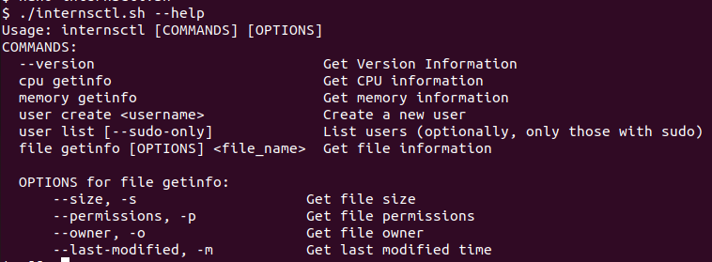
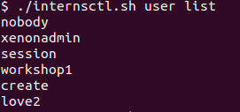
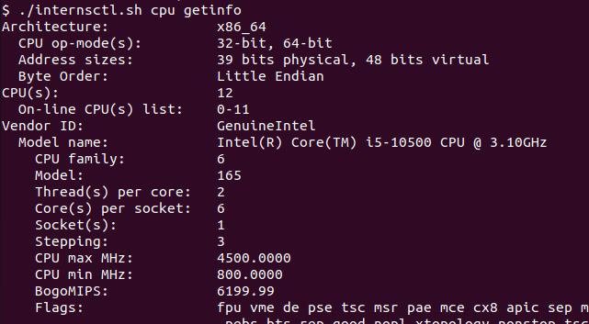
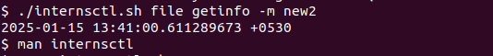
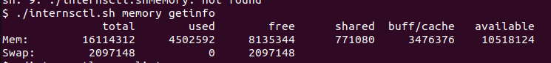
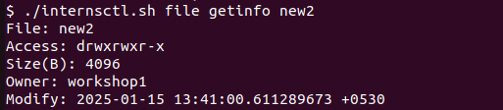
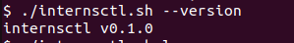
Task Insights
Github Link: Link or visit https://github.com/Lovepreet5555/xenonmodule3

Slide 20
Thank you
Lovepreet Singh
XS0905

